Slide 1
Proposal for a Framework to detect News Bias in English Newspapers
Antonio Curado & Morten Dahl
M20180032@novaims.unl.pt, M20180047@novaims.unl.pt
Notes:
1
xià wǔ hǎo

Slide 2

Motivation
Provide support to detect biasness and tendentious media coverage
create transparency which newspapers tend to publish more tendentious articles
initial notions towards an automated biasness detection in media coverage

Slide 3

Methods
Web Scrapping of well-known english newspapers to build a corpus
preprocessing and cleaning -> filterwords ["Trump", "Brexit", "Syria"]
LDA Analysis for topic detection
Sentiment Analysis to measure tendencies
Interactive framework

Slide 4
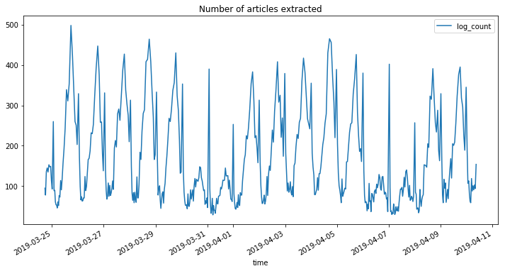
Web Scrapping
Dataset with over 70.000 news articles
Scraped over 19 newspaper for 2 weeks
With an average of 3.600 news articles per newspaper

Slide 5
LDA Analysis
Aims to detect topics within the articles
Model hyperparameters were trained (#Topics, Alpha, Eta) -> measured based on coherence score
Result was analysed based on its assessment
0.033*"border" + 0.016*"mexico" + 0.016*"trump"
+ 0.010*"immigration" + 0.008*"states" + 0.008*"united"
+ 0.008*"president" + 0.007*"illegal" + 0.007*"migrants"
+ 0.006*"people"
Figure 1: Example Topic for keyword "Trump"

Slide 6

Sentiment Analysis
Search for polarity in newspaper
Quantifying polarity with a word dictionary -> score for each article

